Slide 1

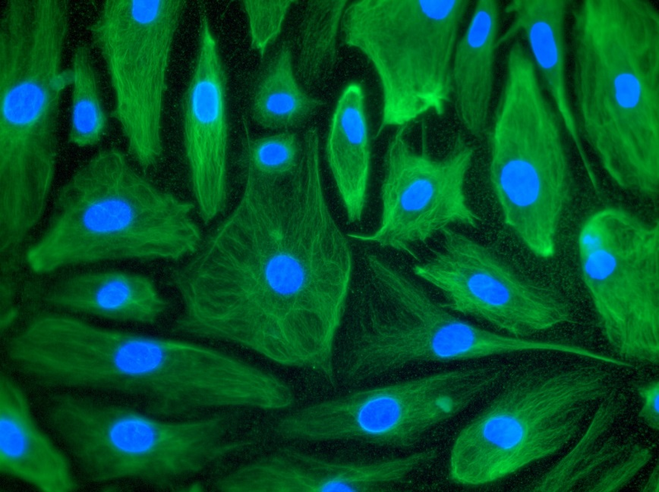
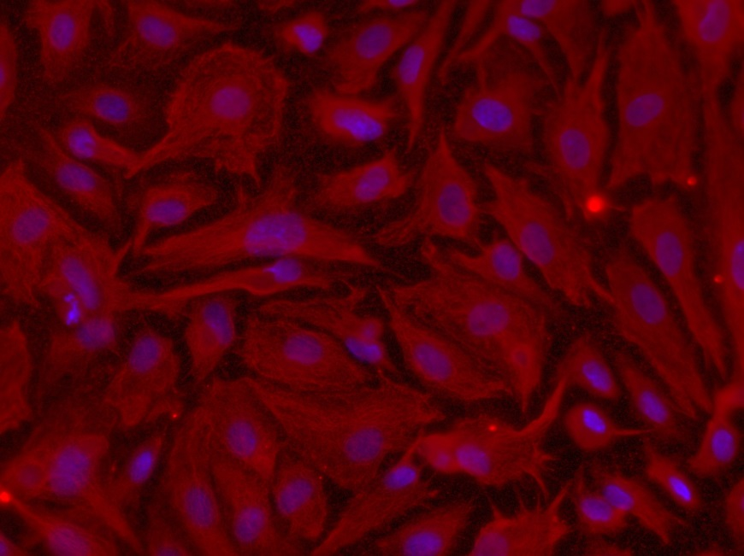
Reliatech GmbH
Mouse anti-human Podoplanin (#101-M40)
Immunofluorescence staining of human Podoplanin in primary human dermal lymphatic endothelial cells (HDLEC) using a monoclonal mouse anti-human Podoplanin (Reliatech #101-M40) as primary antibody. Secondary antibodies: goat anti-mouse IgG-Alexa Flour 488 (Dianova #115-546-062) [Left panel] and goat anti-mouse IgG-PE (Santa Cruz #sc-3738) [right panel].
.
http://www.reliatech.de / orders@reliatech.de

